Slide 1



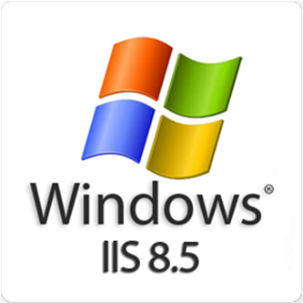


ASP.NET Deployment in IIS
How to Deploy ASP.NET Web Applications in IIS?

Slide 2

Table of Contents
IIS Intro & History
Installing IIS / IIS Express
Deploying ASP.NET Apps in IIS
Sites, Application Pools, Applications
Deploying Simple ASP.NET Application
Web Publishing from Visual Studio
Deploying Data-Driven Application
Configuring a Domain + SSL

Slide 3
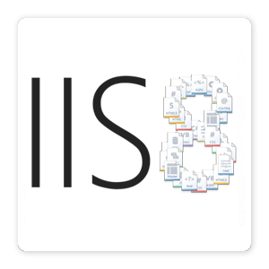
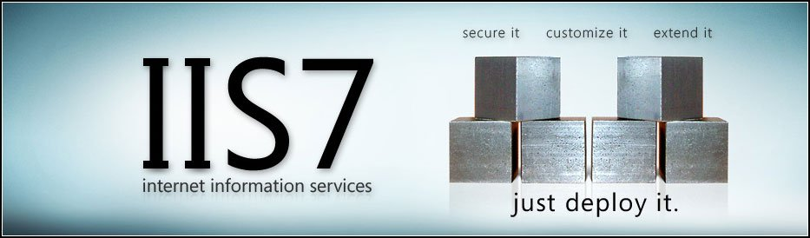
Internet Information Services (IIS 6.0 / 7.0 / 7.5 / 8.0 / 8.5)

Slide 4
Internet Information Services (IIS)
Internet Information Services (IIS) is a Web server (HTTP server)
Microsoft's Web server, part of Windows Server
Serves static and dynamic content (through the ISAPI interface)
IIS hosts and runs ASP.NET Web applications
IIS processes
World Wide Web Publishing Service (iissvcs in svchost.exe) holds the IIS core runtime
IIS Worker Process (w3wp.exe) hosts the application pools which host the ASP.NET runtime and the ASP.NET apps

Slide 5
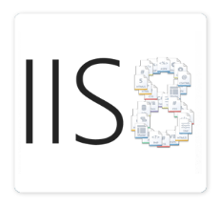
IIS: History and Versions
IIS 5.1 (Windows XP)
10 simultaneous connections, a single Web site
IIS 6.0 (Windows Server 2003)
Faster and more secure, supports application pools
IIS 7.0 (Windows Vista / Server 2008)
Can restrict machine resources per user / app
IIS 7.5 (Windows 7 / Server 2008 R2)
IIS Express – limited developer edition
IIS 8 (Windows Server 2012)
IIS 8.5 (Windows Server 2012 R2)

Slide 6
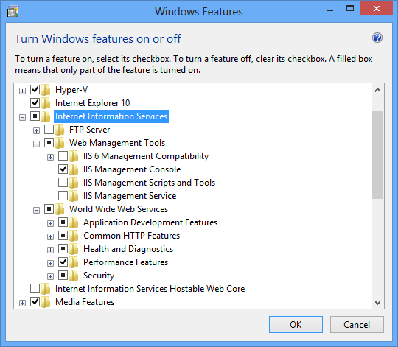
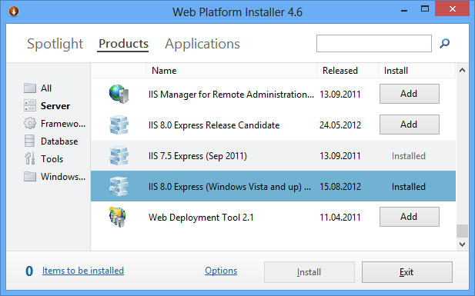

Installing IIS / IIS Express
Turn On / Off Windows Features, Web Platform Installer

Slide 7
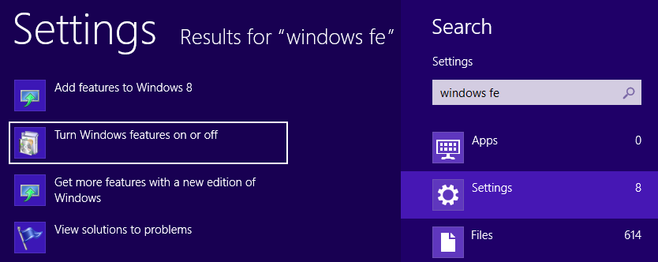
Installing IIS
IIS is part of Windows (Win7, Win8, Windows Server 2008, Windows Server 2012, …)
Installed by "Turn Windows features on or off"

Slide 8
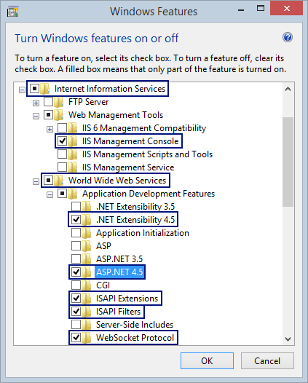
Installing IIS (2)
IIS features to install:
Internet Information Services
ASP.NET 4.5 + .NET Extensibility 4.5
ISAPI Filters + ISAPI Extensions
WebSocket Protocol (for SignalR)
IIS Management Console

Slide 9
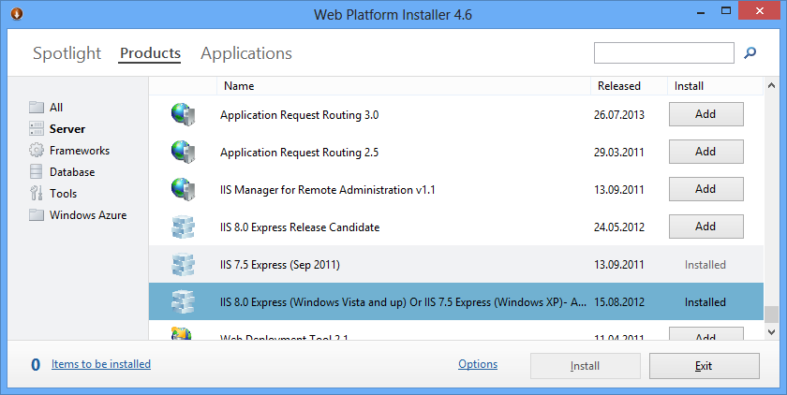
IIS Express and the Web Platform Installer
Web Platform Installer (Web PI) can install IIS Express
Installs Web servers, applications and tools

Slide 10


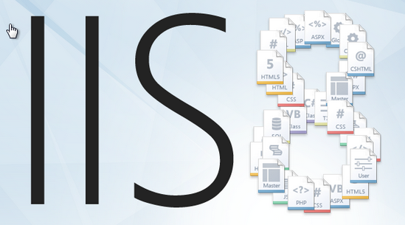
Deploying ASP.NET Apps in IIS
Sites, Applications, Application Pools, DB, …

Slide 11
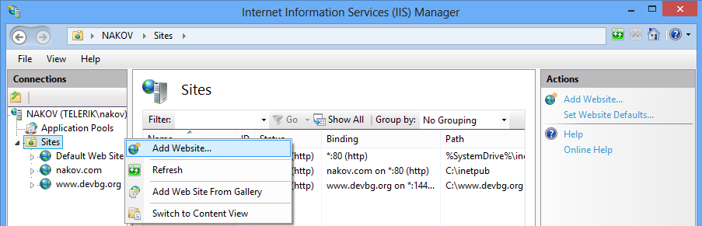
Web Sites in IIS
Sites in IIS
Instances of the IIS Web server, hosting files and applications
Sites are bound to some protocol + host + port
E.g. http://mysite.com, https://localhost:8443

Slide 12
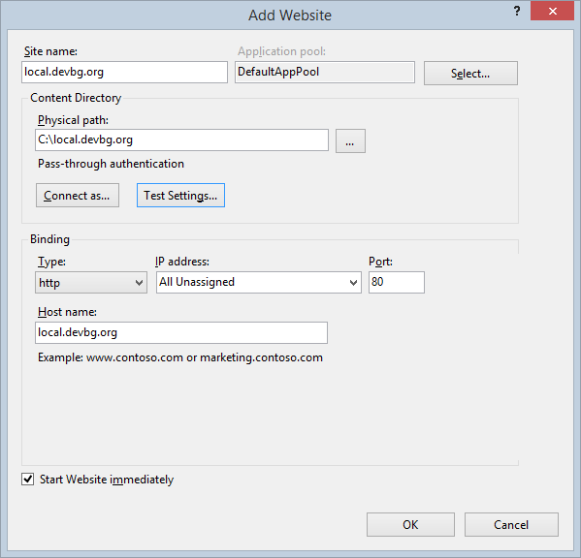
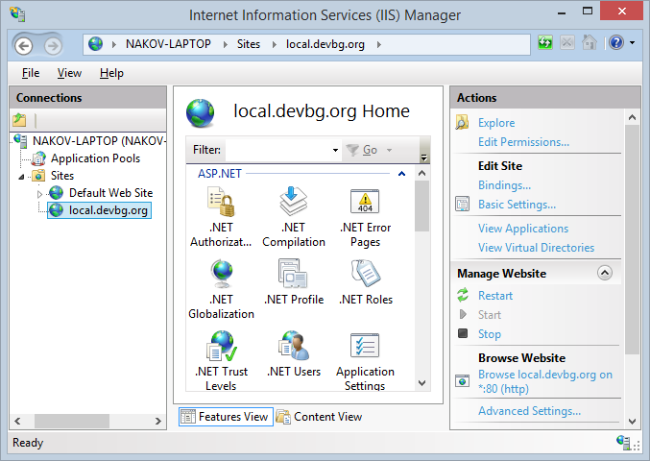
Web Sites in IIS (2)

Slide 13
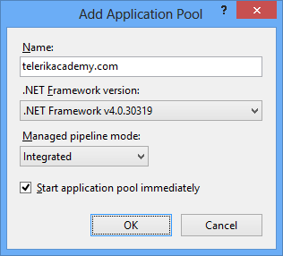
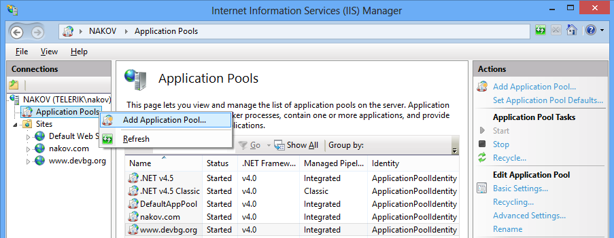
Application Pools in IIS
Application pools host Web applications in IIS
A process group that run the ASP.NET runtime
Can configure CPU usage, memory limits, identity (Windows user)

Slide 14
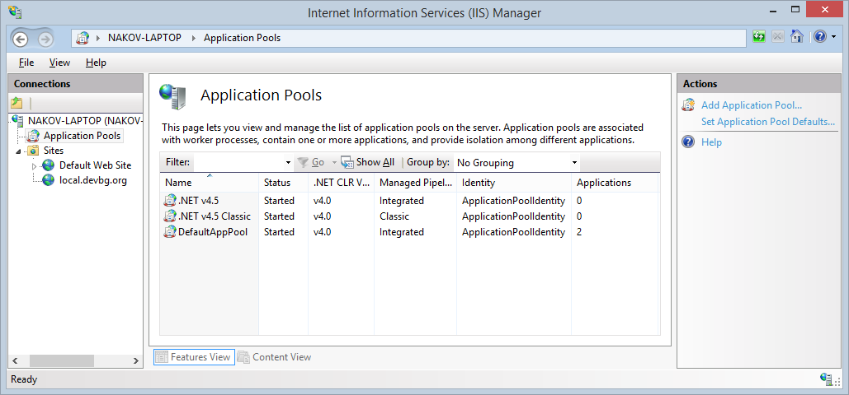
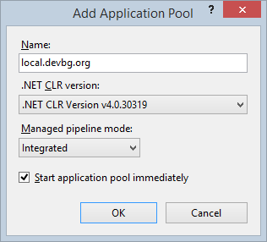
Application Pools in IIS (2)

Slide 15
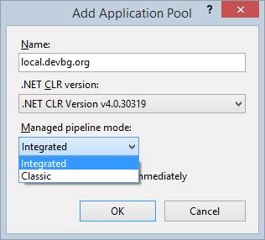
Pipeline Mode for IIS Application Pools
Managed pipeline mode:
Classic
Use ASP.NET as external IIS plugin, like the PHP and Perl interpreters
Integrated (recommended)
ASP.NET is integrated inside IIS
ASP.NET can control the request pipeline, e.g. through HttpModule and HttpHandler

Slide 16
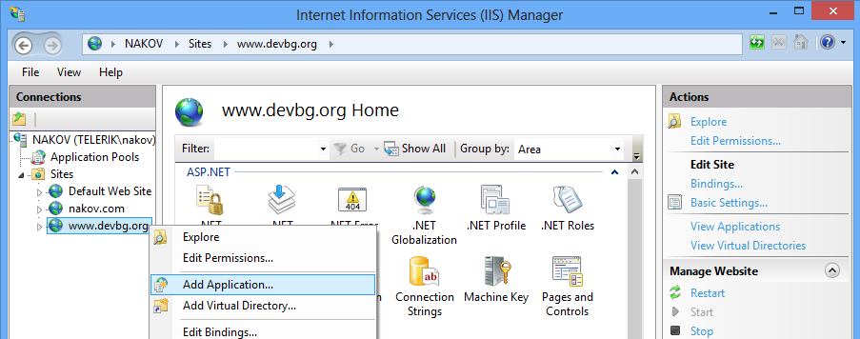
Applications in IIS
Applications in IIS are
Physical directory with files (application code)
Belong to existing Web site and run in existing application pool
Have alias (virtual directory), e.g. http://localhost/alias/

Slide 17
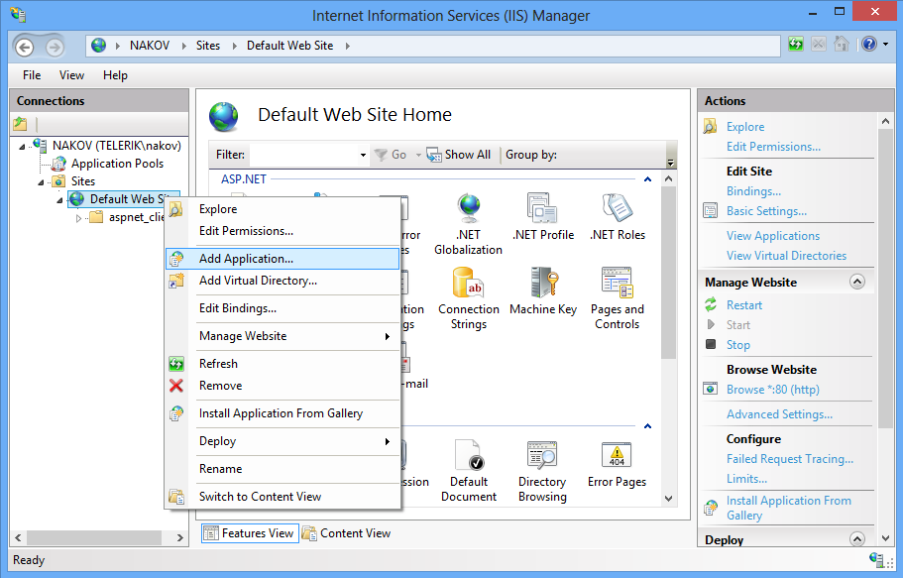
Creating an Application in IIS

Slide 18
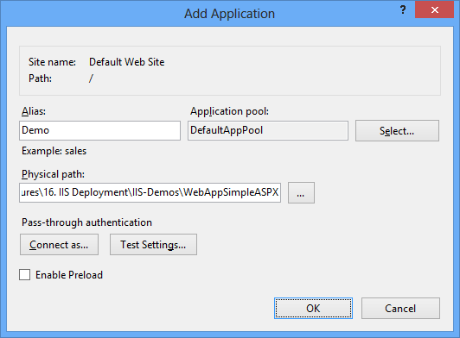
Creating an Application in IIS (2)

Slide 19
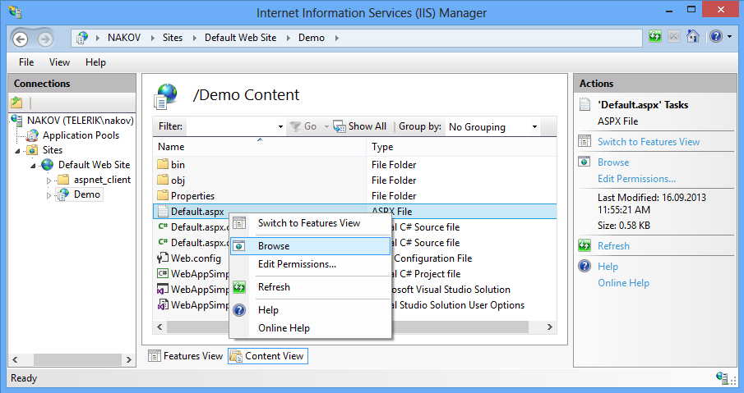
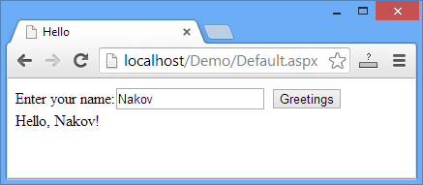
Creating an Application in IIS (3)

Slide 20
What Files to Deploy in the Production IIS?
Files to copy to the IIS application directory:
Views, pages, controls: *.cshtml, *.aspx, *.Master, *.ascx
Resources: *.jpg, *.png, *.gif, *.css, *.js, fonts, …
Compiled C# files: bin\*.dll
Config files: Web.config, Global.asax
Don't deploy these files:
Source code: *.cs, *.csproj, *.sln
Databases: *.mdf / *.ldf (deploy separately in SQL Server)

Slide 21

Hosting Simple ASP.NET Application in IIS
Live Demo

Slide 22
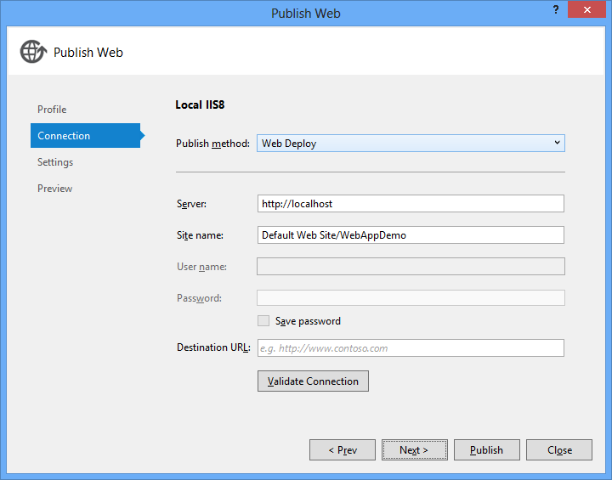

Web Publishing from Visual Studio
Publish Web App from VS to IIS

Slide 23
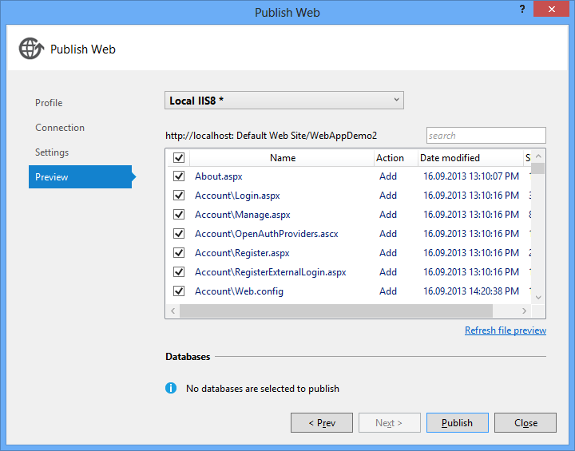
Web Publishing in Visual Studio
Visual Studio provides a Web Publishing Wizard
Used to deploy ASP.NET Web apps to remote IIS
Supports local deploy (in the file system), Web deploy, deploy package, FTP
Uses pre-configured publish profiles

Slide 24
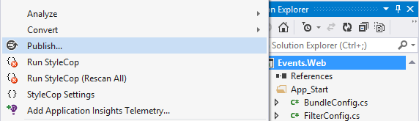
Web Publishing in Visual Studio (2)
Click on the Web project and choose [Publish…]

Slide 25
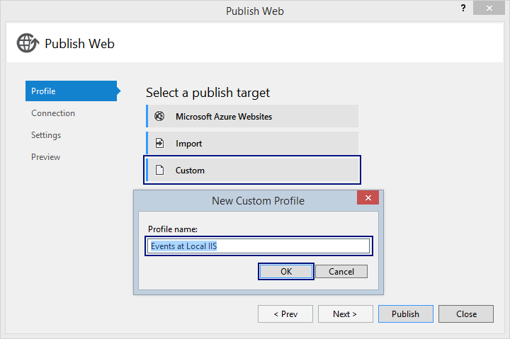
Web Publishing in Visual Studio (3)
Create a New Custom Profile

Slide 26
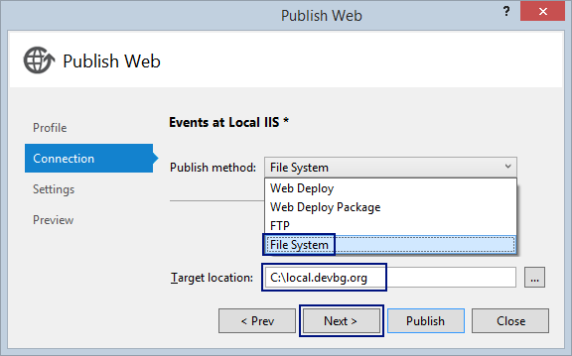
Web Publishing in Visual Studio (4)
Web Deploy: deploy to IIS
Remote deploy requires IIS Web Management Service (WMSvc)
Web Deploy Package:
Create a ZIP package for later deployment to IIS
FTP: deploy with FTP upload
File System: deploy to a local folder

Slide 27
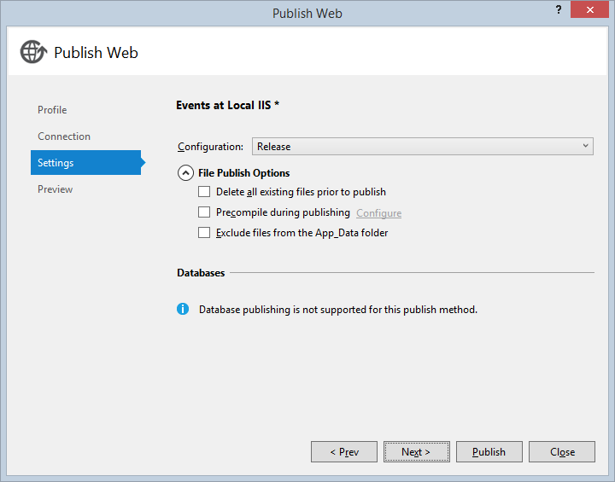
Web Publishing in Visual Studio (5)

Slide 28
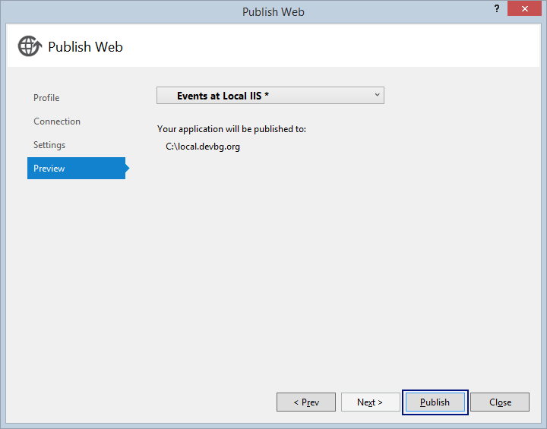
Web Publishing in Visual Studio (6)

Slide 29
Web Publishing from VS
Live Demo

Slide 30
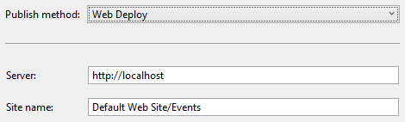

Web Deploy from IIS to Visual Studio
Visual Studio can directly deploy a Web application to IIS
Use the Web Publish Wizard → Web Deploy
Remote IIS deploy requires
IIS Web Management Service (WMSvc) running at the remote host
Proper firewall configuration: open TCP port 8172
Local IIS deploy requires Visual Studio running as Administrator

Slide 31
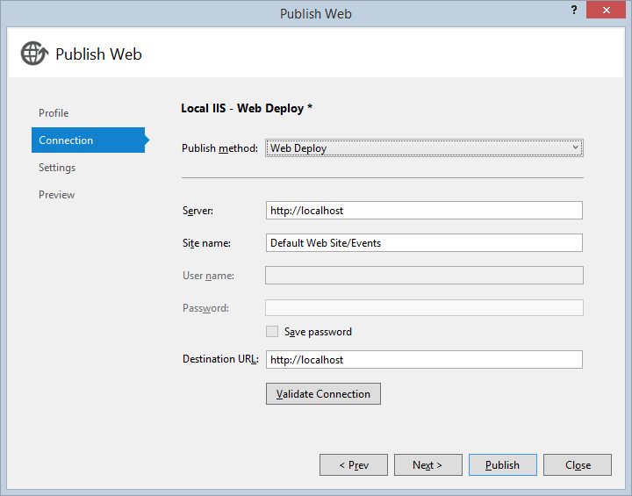
Web Deploy from Visual Studio to IIS
Live Demo

Slide 32

Deploying Data-Driven Applications in IIS
Configuring IIS to Access SQL Server

Slide 33
Configuring IIS to Access SQL Server
Typically in IIS your application runs under the user "IIS APPPOOL\DefaultAppPool" (or you app pool's user)
This user cannot login in SQL Server (can't establish connection)
This user has no permissions for your database in SQL Server
To access the SQL Server DB from IIS:
Configure the database connection string in Web.config
Create a SQL Server login "IIS APPPOOL\DefaultAppPool"
Assign "db_owner" database role for this login for your DB

Slide 34
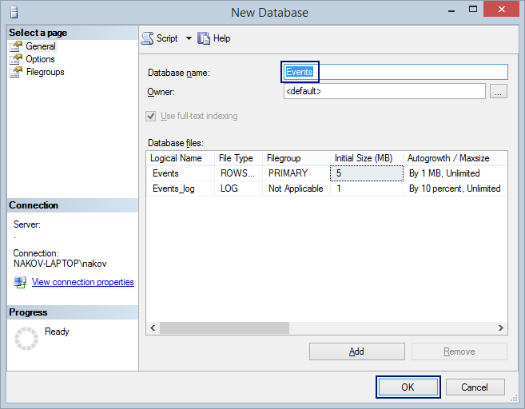
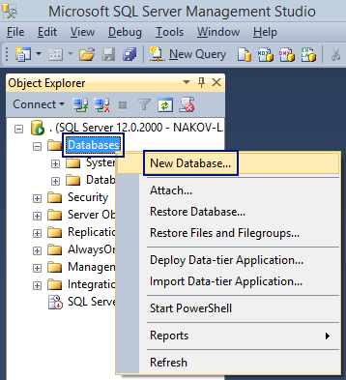
Step 1: Create a Database
Create a new database for your Web application in SQL Server, e.g. "Events"

Slide 35
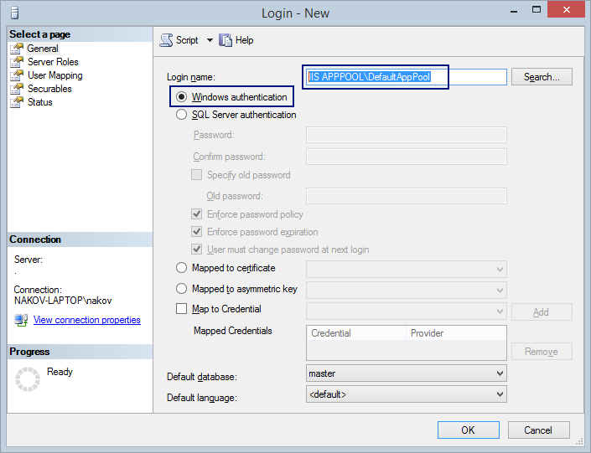
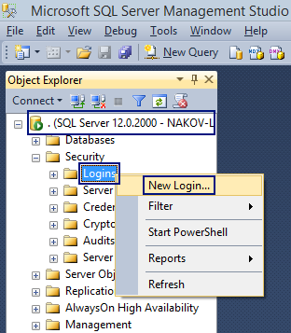
Step 2: Create IIS Login in SQL Server
Create a new login for the "IIS APPPOOL\DefaultAppPool" Windows user in SQL Server

Slide 36
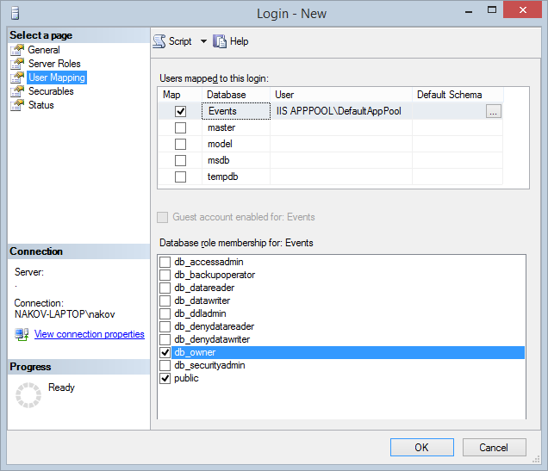
Step 3: Assign Permissions to Access the DB
Assign permissions for the new SQL Server login "IIS APPPOOL\DefaultAppPool" to access your Web app DB
Select your Web application's database, e.g. "Events"
Assign role "db_owner" (full access)
That's all, enjoy!

Slide 37
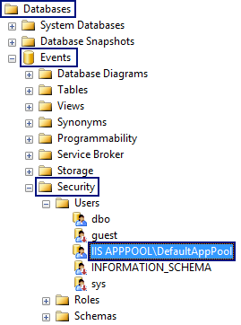
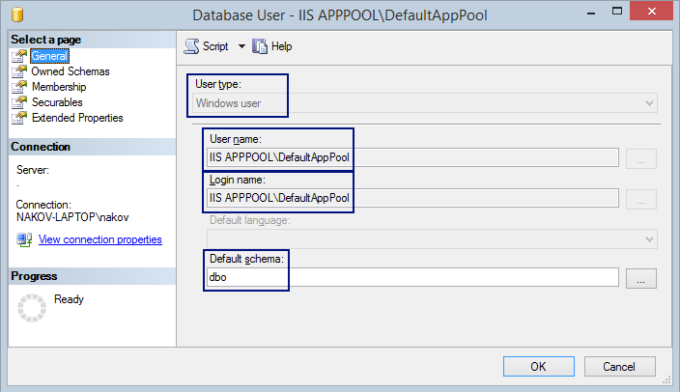
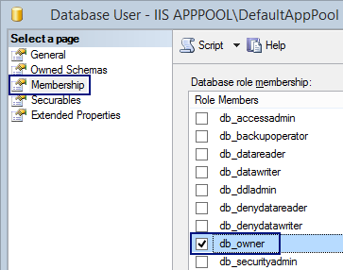
What Happened in the SQL Server?
A Windows user "IIS APPPOOL\DefaultAppPool" was created in the "Events" database with "db_owner" role:

Slide 38
Deploying Data-Driven Applications in IIS
Live Demo

Slide 39


Configuring Domains + SSL in IIS

Slide 40
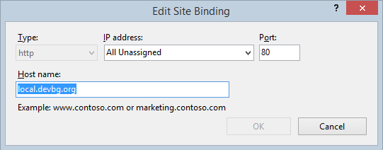
Configuring a Domain in IIS
Assign the server IP address for your domain name in the DNS
From the admin panel of your domain hosting provider
E.g. assign softuni.bg == 217.174.159.195
Assign the host name in the Web site binding in IIS:

Slide 41
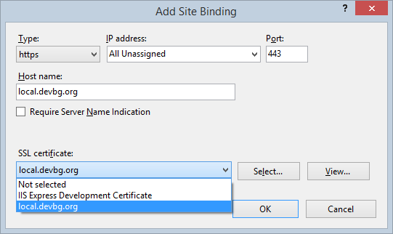
Configuring SSL in IIS
To configure SSL in IIS, you need to have a server SSL certificate

Slide 42
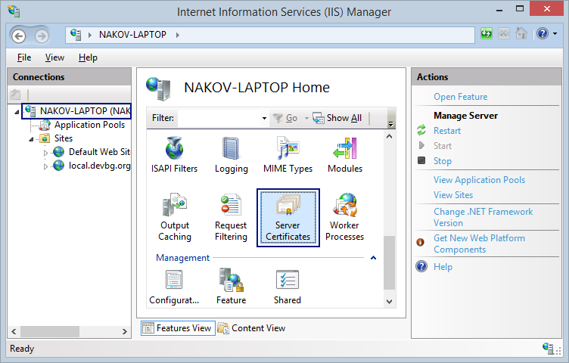
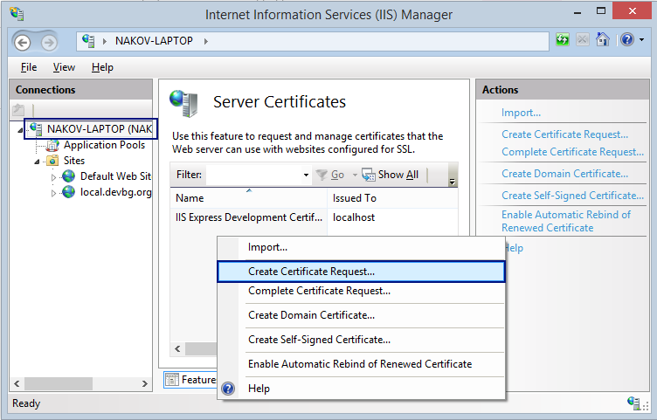
Requesting New SSL Certificate

Slide 43
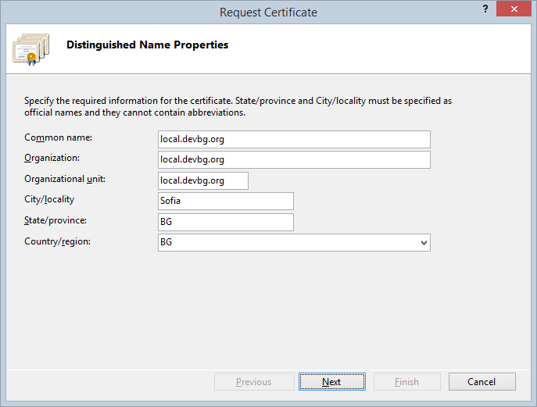
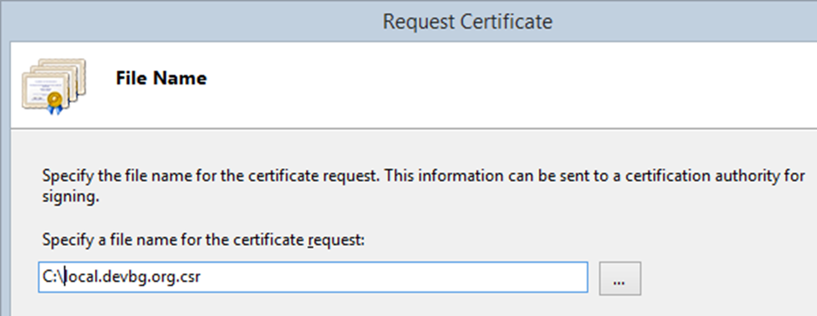
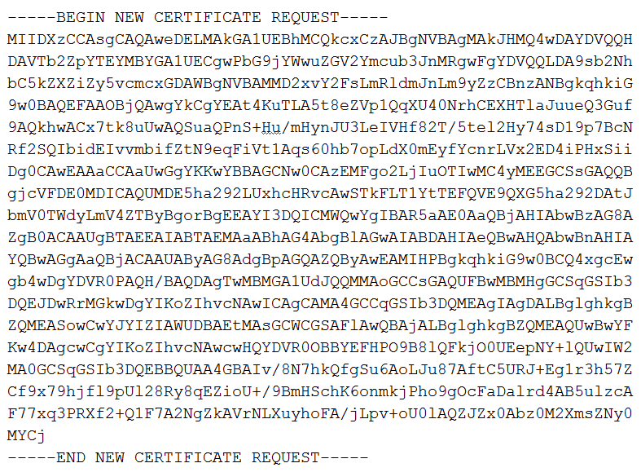
Requesting New SSL Certificate (2)

Slide 44
Requesting New SSL Certificate (2)
Sign the CSR to issue the certificate
Different SSL providers have different domain validation process
Comodo Instant SSL provide 90-days free SSL certificates: https://www.instantssl.com/free-ssl-certificate.html
Once the domain ownership is verified, provider will issue the certificate (typically X.509 .crt file)
You can self-sign the CSR (e.g. by OpenSSL)
The certificate will be invalid, but can be used for testing purposes

Slide 45
Self-Signing a CSR with OpenSSL
Your CSR can be signed by yourself, using OpenSSL:
# Generate a private key for the signing process
openssl genrsa -passout pass:foobar -out server.key 1024
# Sign the CSR with the private key to obtain the .CER file
openssl x509 -req -days 3650 -in local.devbg.org.csr -signkey server.key -passin pass:foobar -out local.devbg.org.crt
# Export the certificate with private key as PKCS#12 (pfx file)
openssl pkcs12 -export -in local.devbg.org.crt -inkey server.key -passin pass:foobar -out local.devbg.org.pfx -passout pass:foobar -name "local.devbg.org"

Slide 46
Configuring Domains + SSL in IIS
Live Demo

Slide 47

Summary
IIS is the Microsoft's Web server
Hosts static Web sites and ASP.NET Web applications
Visual Studio has very powerful Web Publishing Wizard
Deploy to directory, local or remote IIS
To access SQL Server from IIS, create a new login and give permissions to your database
To use SSL, you need to request, issue and install a certificate

